Slide 1
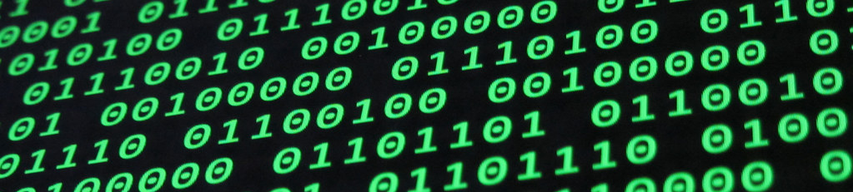
Topic 2
Data Representation

Slide 2
What language do computers think in?

Slide 3






101010010100100100100100101001001001001010010010010001001100110
To interpret information, computers use binary language based in bits.

Slide 4
Bits

Slide 5
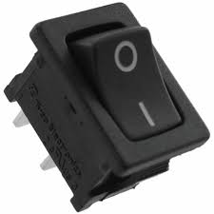


Binary digIT
A bit is the most basic unit of information in the digital world. A bit can be represented using two values: 0 or 1.
Other representations such as TRUE or FALSE, or on and off.

Slide 6


Slide 7
Binary digIT
Why do we use bits?

Slide 8
1
Transistors have two states: on / off
2
Data storage is more reliable when using 2 posible states
3
Processing of data in binary is quick and

Slide 9
Assume we have the following readings from a hard disk drive.
0 = 0V to 1.75V
1 = 1.76V to 3.5V
3.4
3
0.5
0.7
3.3
3.1
0.73
0.35
0.6
0.7
0.8
2.2

Slide 10

0V to 1.75V
1.76V to 3.5V
3.4
3
0.5
0.7
1
1
0
0
3.3
3.1
0.73
0.35
1
1
0
0
0.6
0.7
0.8
2.2
0
0
0
1
0.8

Slide 11
0V to 1.75V
1.76V to 3.5V
3.4
3
0.5
0.7
1
1
0
0
3.3
3.1
0.73
0.35
1
1
0
0
0.6
0.7
1.74
0.8
2.2
0
0
0
1
Even though external factors affected a memory sector, no data corruption ocurred

Slide 12
Now we assume we have 4 ranges:
0 = 0V to 0.75V
1 = 0.76V to 1.50V
2 = 1.51 to 2.25V
3 = 2.26V to 3.0V
1.76
2
1
0
2.5
2.2
1.2
0.9
0.8
1.6
1.74
2.2

Slide 13
0V to 0.75V
0.76V to 1.5V
1.51V to 2.25V
2.26V to 3.0V
1.76
2
1
0.75
2
2
1
0
2.5
1.51
1.2
0.9
3
2
1
1
0.8
1.6
1.74
2.2
1
2
2
2

Slide 14
0V to 0.75V
0.76V to 1.5V
1.51V to 2.25V
2.26V to 3.0V
1.76
2
1
0.75
2
2
1
0
2.5
1.51
1.2
0.9
3
2
1
1
0.8
1.6
1.74
1
2
2
2
2.26
2.2
A small interference on the data array impacts the contents of the registers. The more ranges there are, the higher risk of data corruption.

Slide 15
Bits y Bytes

Slide 16
Byte
A single bit
1
A group of 8 bits is known as a byte.
0
1
0
0
0
0
1
0

Slide 17

Internet Speed
How is data bandwidth measured by your ISP?
(Internet Service Provider)
50 Megabits per second
Divide by 8
6.25 Megabytes per second

Slide 18


Metric
IEC Binary
JEDEC Binary
The difference in this systems is if they measure data using powers of 10, or powers of 2

Slide 19
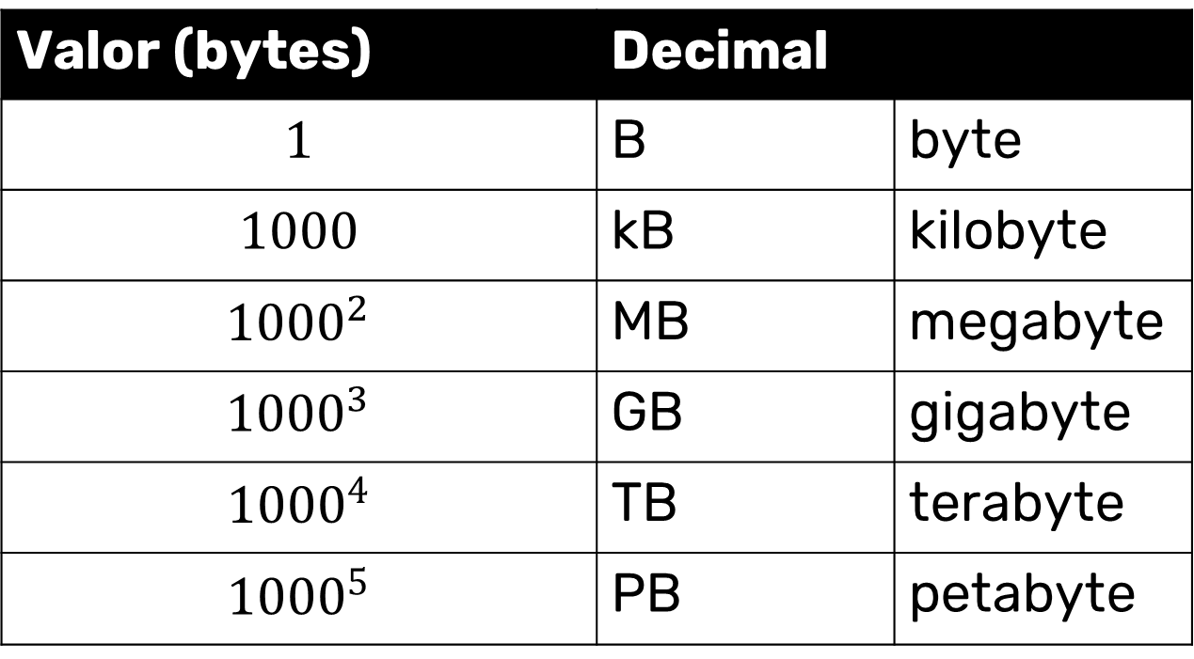
Metric System
Valor (bytes) | Decimal
$$1$$ | B | byte
$$1000$$ | kB | kilobyte
$${1000}^{2}$$ | MB | megabyte
$${1000}^{3}$$ | GB | gigabyte
$${1000}^{4}$$ | TB | terabyte
$${1000}^{5}$$ | PB | petabyte

Slide 20
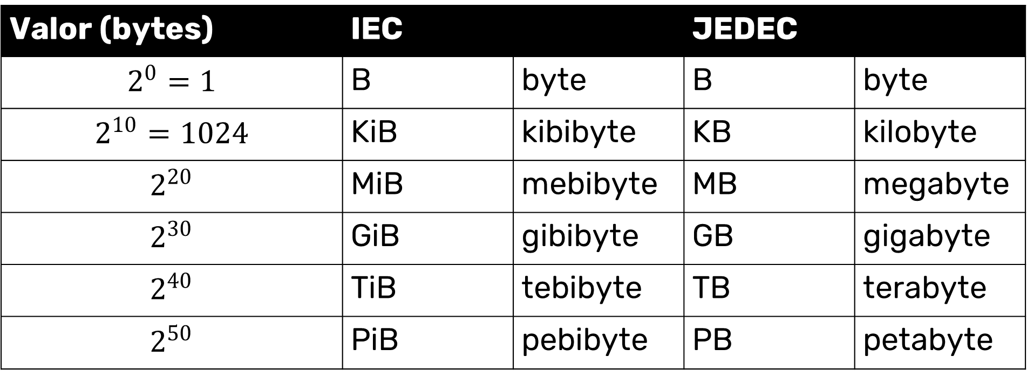
Binary System
Valor (bytes) | IEC |  | JEDEC
$$2^{0}=1$$ | B | byte | B | byte
$$2^{10}=1024$$ | KiB | kibibyte | KB | kilobyte
$$2^{20}$$ | MiB | mebibyte | MB | megabyte
$$2^{30}$$ | GiB | gibibyte | GB | gigabyte
$$2^{40}$$ | TiB | tebibyte | TB | terabyte
$$2^{50}$$ | PiB | pebibyte | PB | petabyte

Slide 21
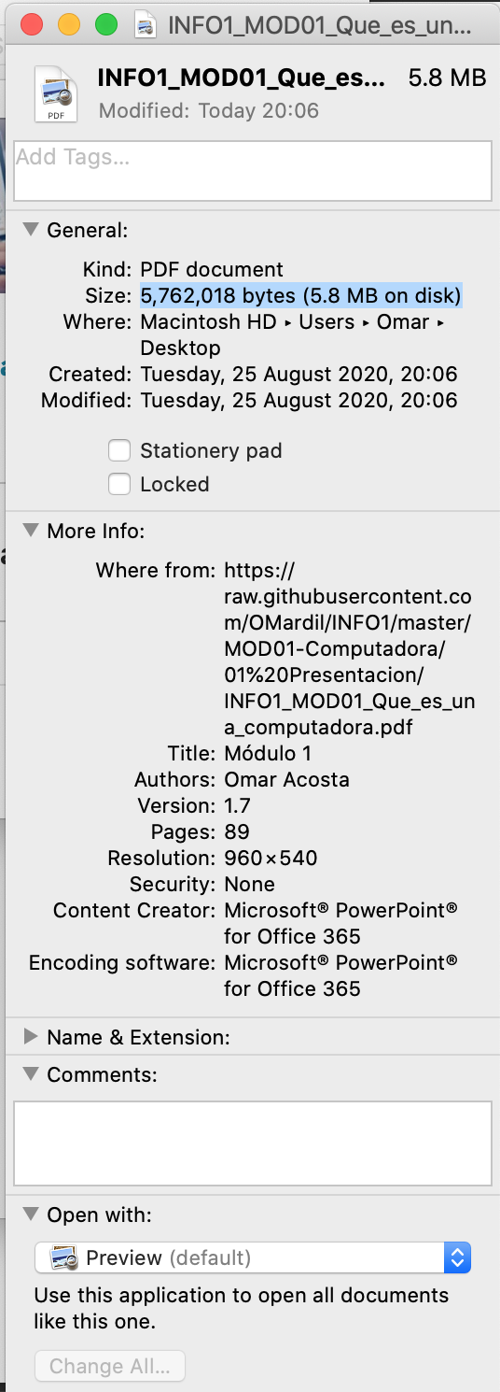
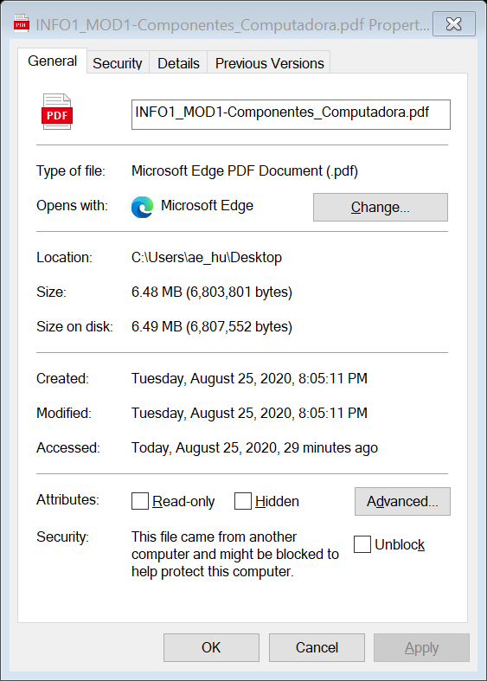
Mac OS uses the metric system (powers of 10) to measure file sizes
Windows uses JEDEC binary system (powers of 2) to measure file sizes

Slide 22
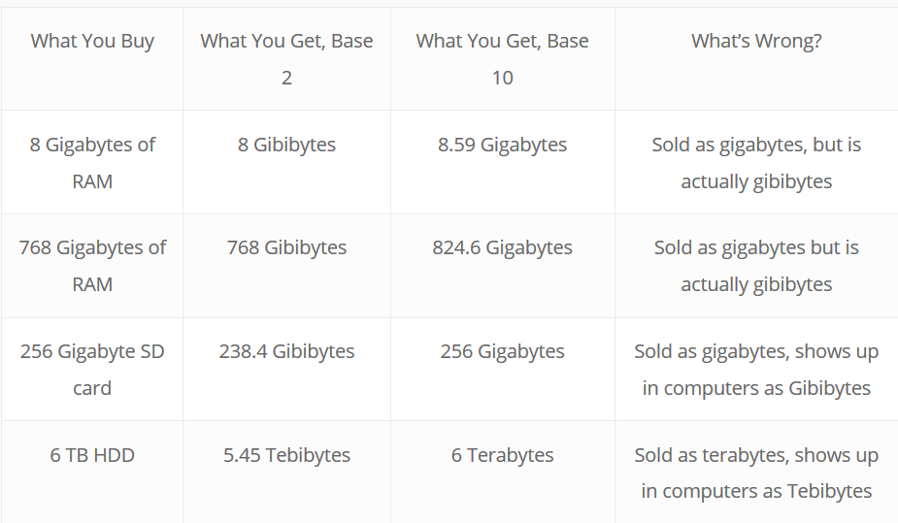

Slide 23
Characters

Slide 24
Characters
Computers use character sets to transmit, store, and process information. Each symbol within a character set is denominated a character.
Each character represents something different:
Sound
Pause
Number
Feeling
etc.

Slide 25
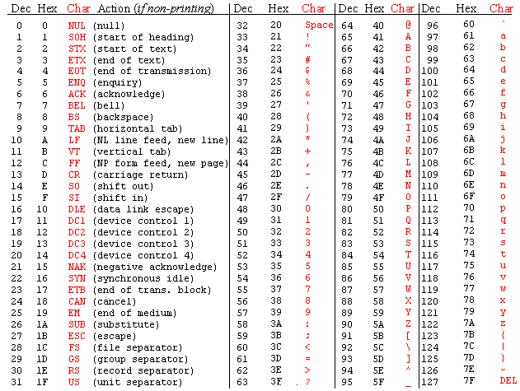
Characters

Slide 26
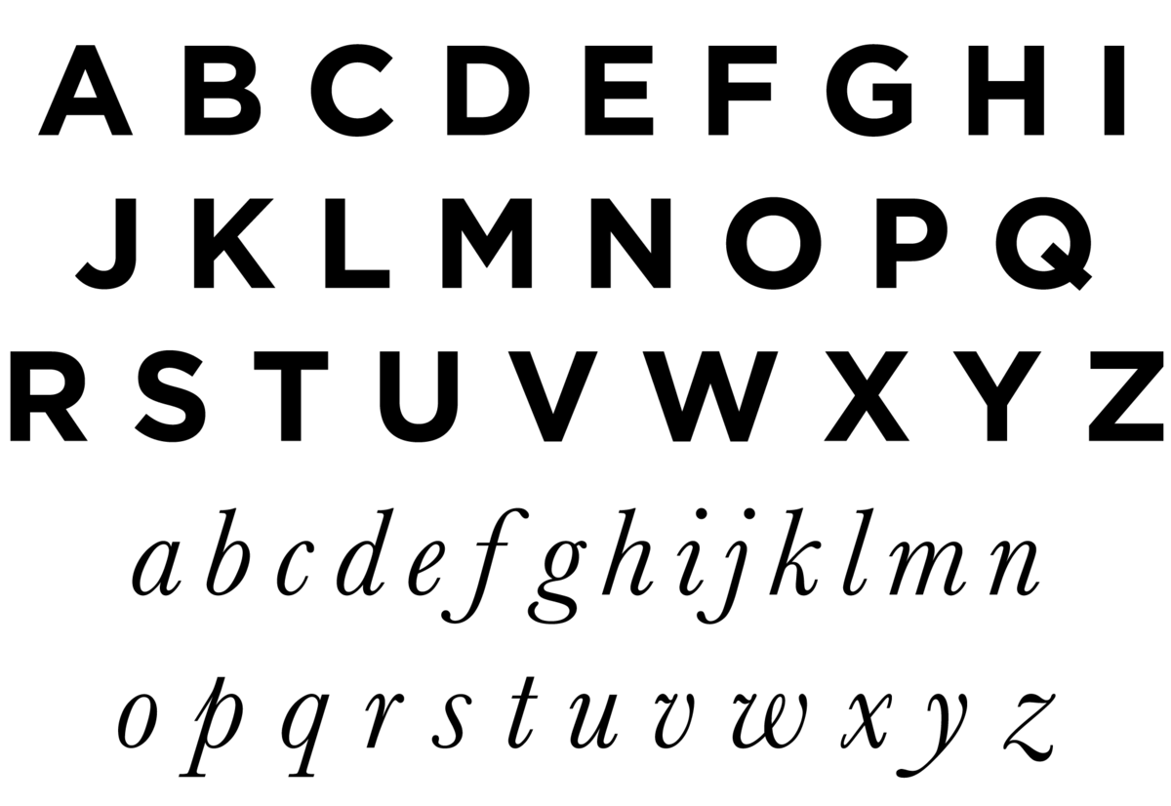
Alphabetic Characters
Represents all 26 letters of the English alphabet, in upper and lower case.

Slide 27
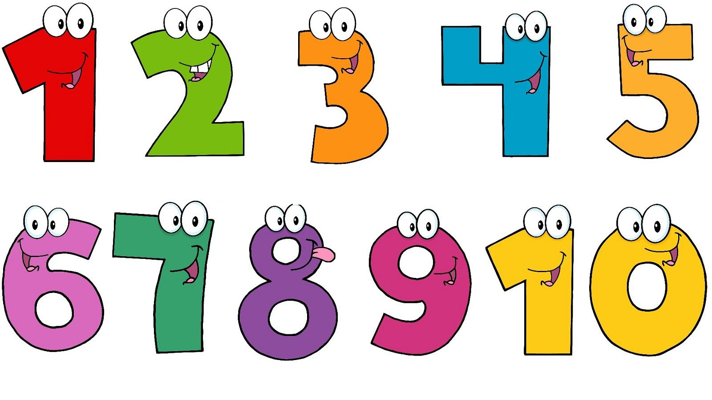
Numeric Characters
Represents numbers using the decimal base. From “0” to “9”.

Slide 28
Special Characters
Special characters from other languages (i.e., Spanish, French, German). They also include characters that transmit emphasis, questions, enumerations, among others.
SPACE
() {} [] < >
@
¡ ! ¿ ?
, . ;
= + - / * %
Ñ ß á ë î

Slide 29
Control Characters
Characters with no graphic representation serve as control characters to indicate tabs, line feeds, segments, etc.
TAB
NULL
BELL
Backspace
Line Feed
Carriage Return

Slide 30
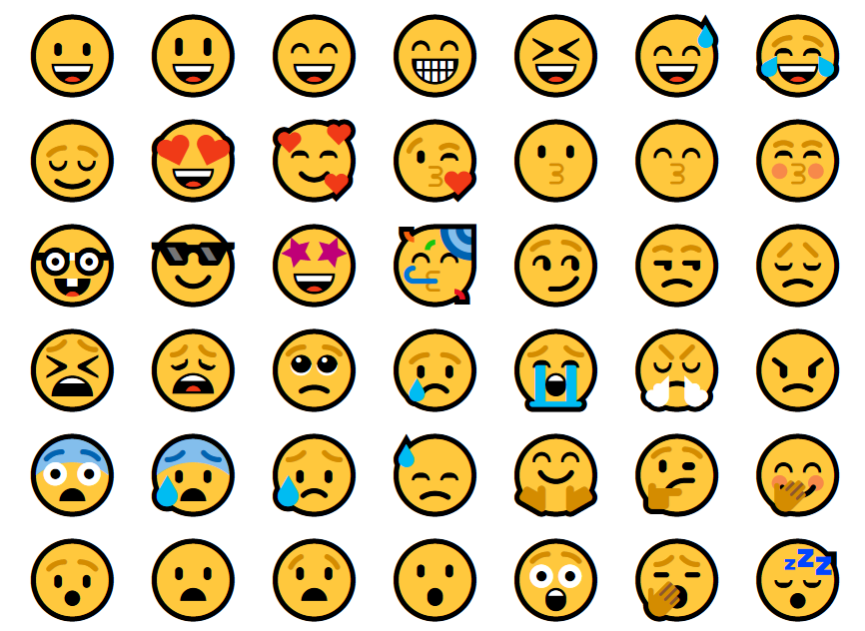
Graphic Characters
® ₿ ℗ ☺
→㱺☞⇏➴⤱☃★
Emojis

Slide 31
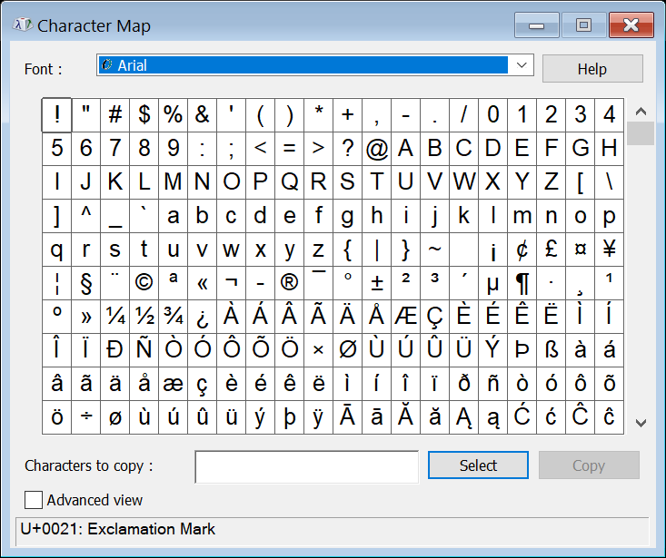
Character Map
In Windows, you can open Character Map to view the different characters

Slide 32
Decimal System

Slide 33
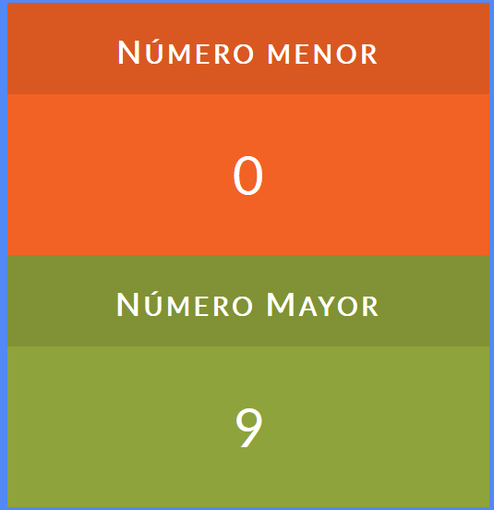
Decimal System
To represent numbers, us humans use the decimal system
This means each position can represent up to 10 different possible values.
Smallest number
Largest number

Slide 34
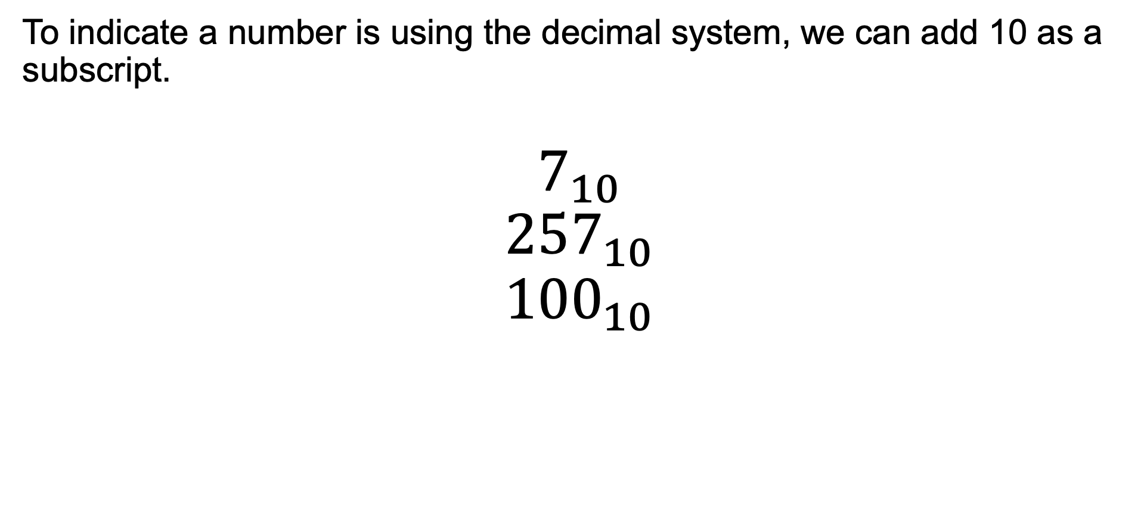
Decimal System
To indicate a number is using the decimal system, we can add 10 as a subscript.
$$7_{10}$$
$${257}_{10}$$
$${100}_{10}$$

Slide 35
0 ← Start with smallest number that we can represent with 1 digit
1
2
3
4
5
6
7
8
9 ← We reach the largest number that can be represented with 1 digit
10 ← We add 1 more digit and start from the smallest number we can represent using two digits
12
13
14
15

Slide 36
Binary System

Slide 37
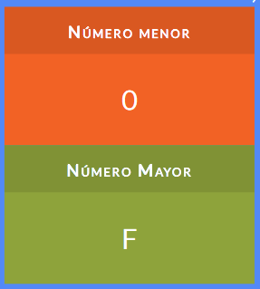
Binary System
Computers represent information using the binary system. Binary has a base of 2, which means each digit can represent two possible values.
Smallest number
Largest number
1

Slide 38
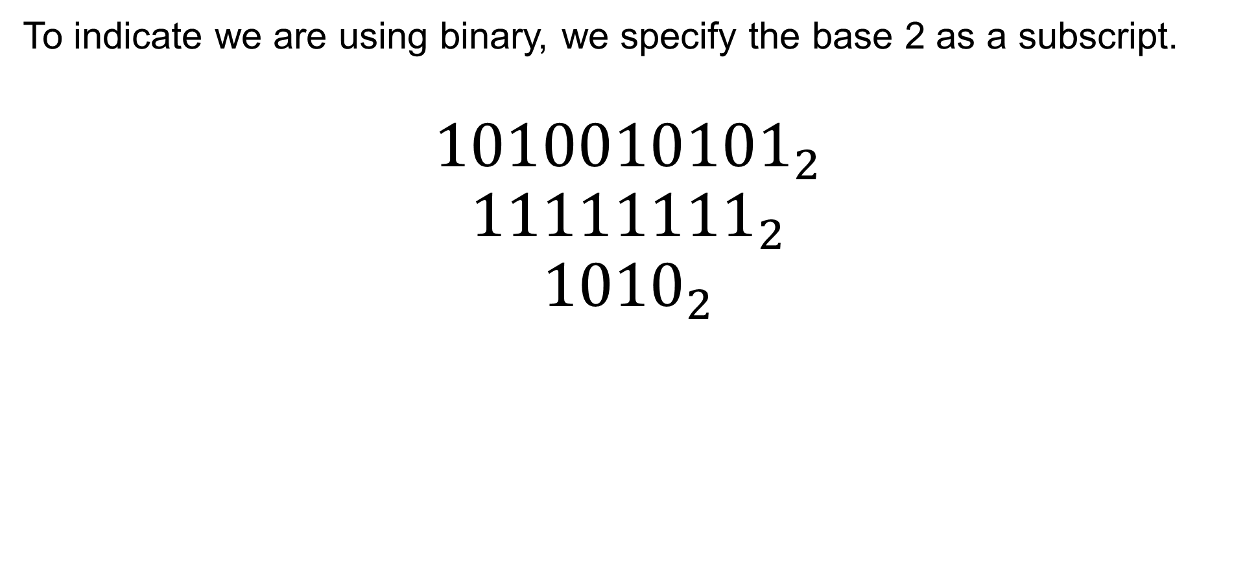
Binary System
To indicate we are using binary, we specify the base 2 as a subscript.
$${1010010101}_{2}$$
$${11111111}_{2}$$
$${1010}_{2}$$

Slide 39
0 ← Start with one digit, with the smallest value in binary
1 ← Largest binary number using one digit
10 ← Increase total number of digits to two
11
100 ← Increment total number of digits to three
101
110
111
1000 ← Increment total number of digits to four
1001
1010
1011
1100
1101
1110
1111

Slide 40
Binary to Decimal Conversions

Slide 41
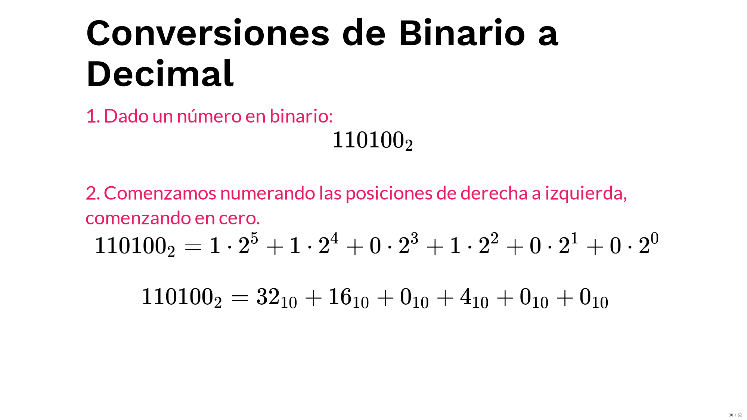
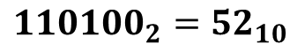
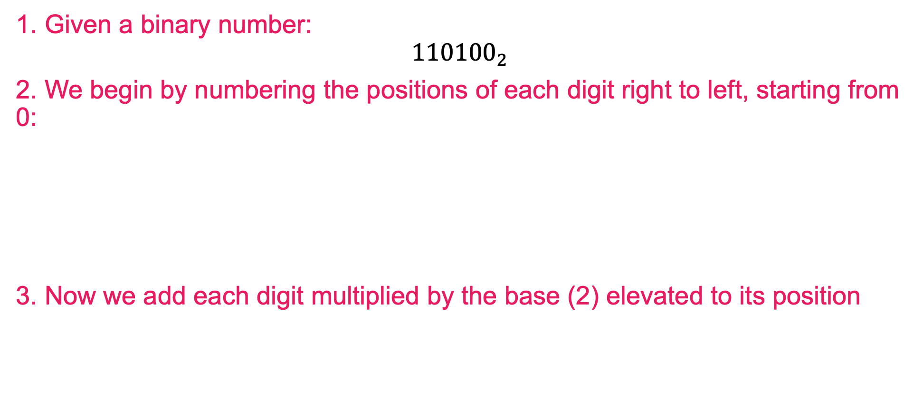
Binary to Decimal Conversion
1. Given a binary number:
$${110100}_{2}$$
2. We begin by numbering the positions of each digit right to left, starting from 0:
3. Now we add each digit multiplied by the base (2) elevated to its position
digits
1
1
0
1
0
0
positions
5
4
3
2
1
0
$${110100}_{2}={52}_{10}$$

Slide 42
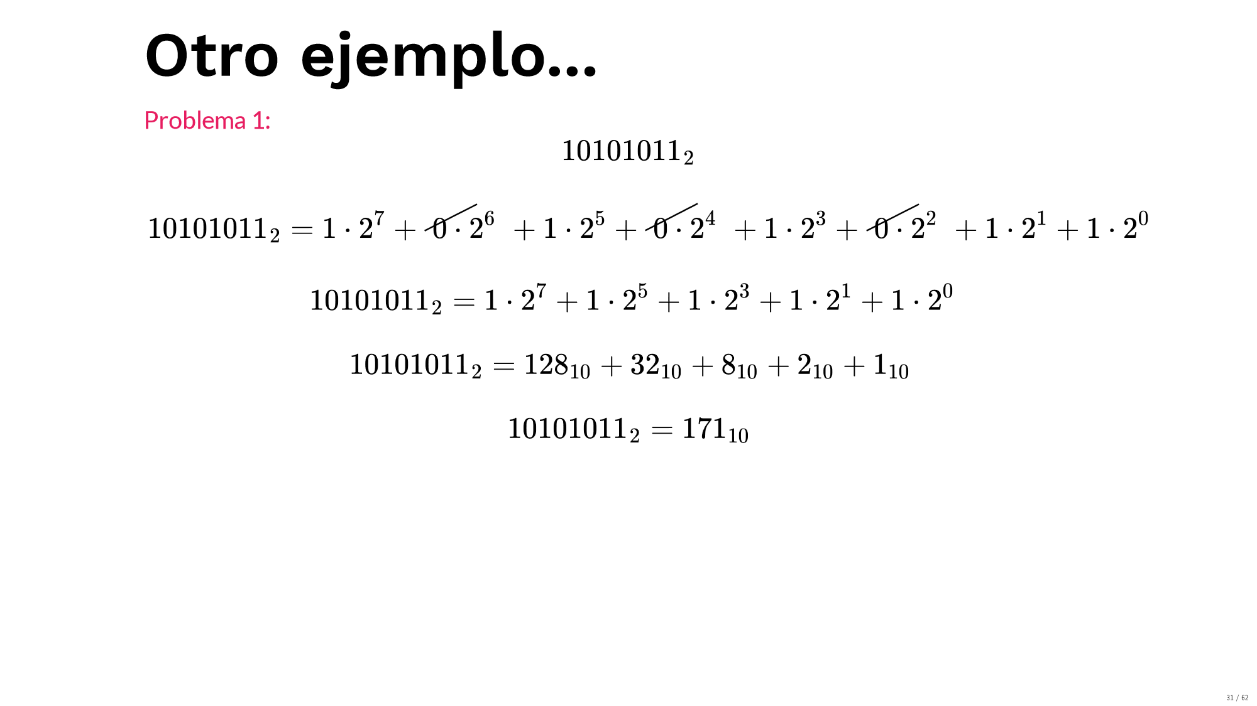
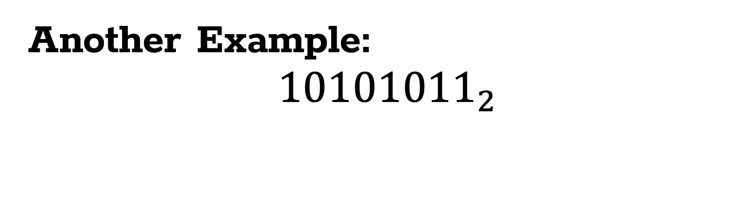
Another Example:
$${10101011}_{2}$$
1
0
1
0
1
0
1
1
7
6
5
4
3
2
1
0

Slide 43
Decimal to Binary Conversion

Slide 44
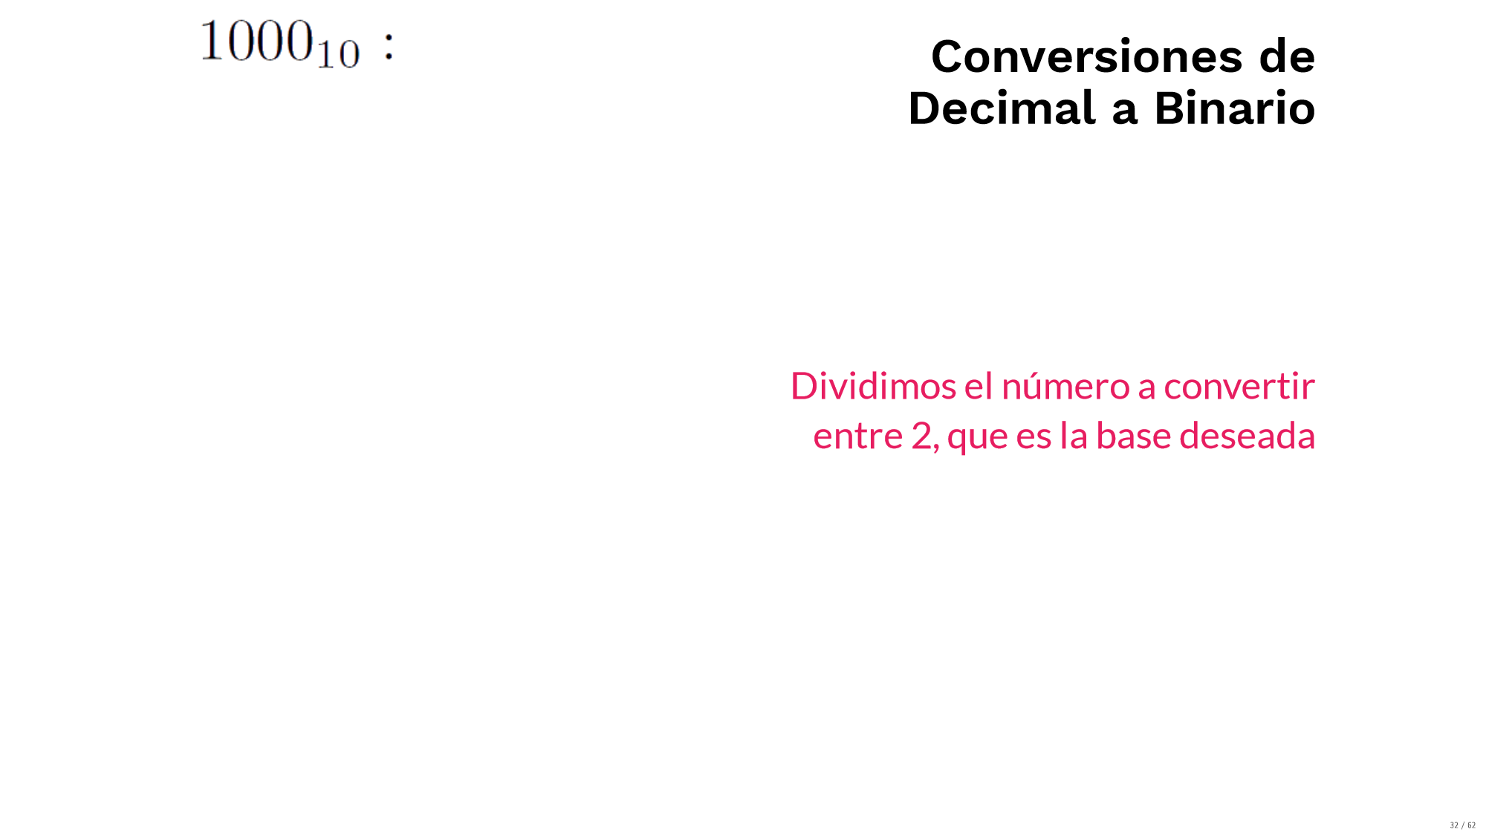
Decimal to Binary Conversion
We divide the decimal number by 2, which is the desired base (base).

Slide 45
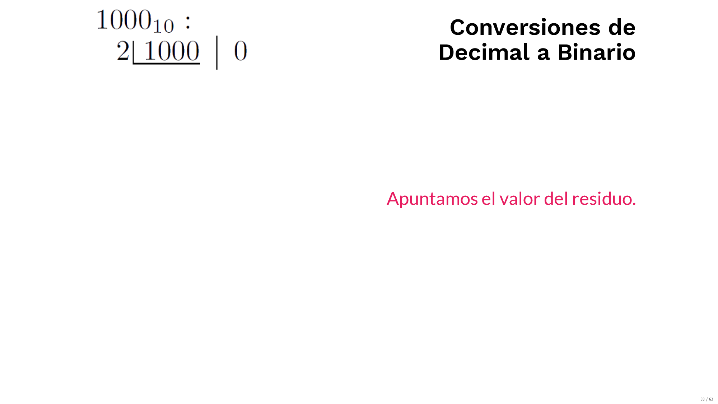
Decimal to Binary Conversion
Remainder
Result
We write down the remainder and the result of the division

Slide 46
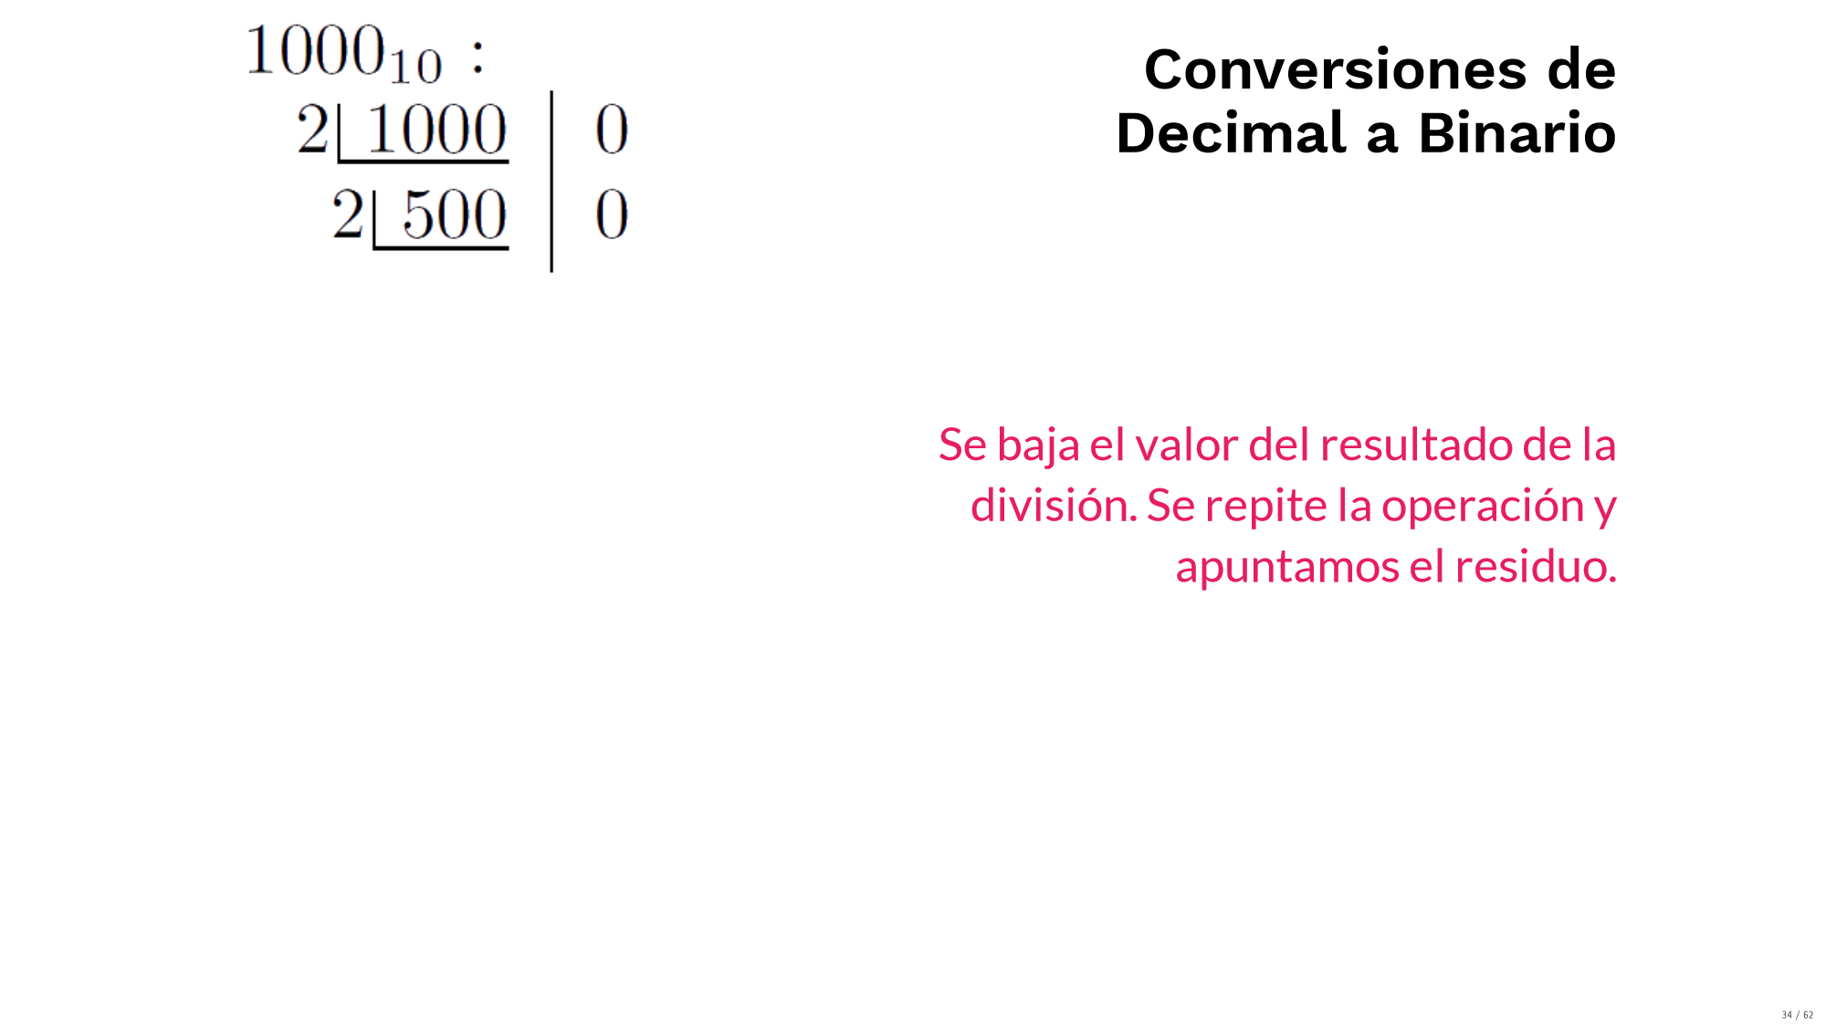
Decimal to Binary Conversion
Remainder
Result
We repeat the operation, we write down the remainder and the result

Slide 47
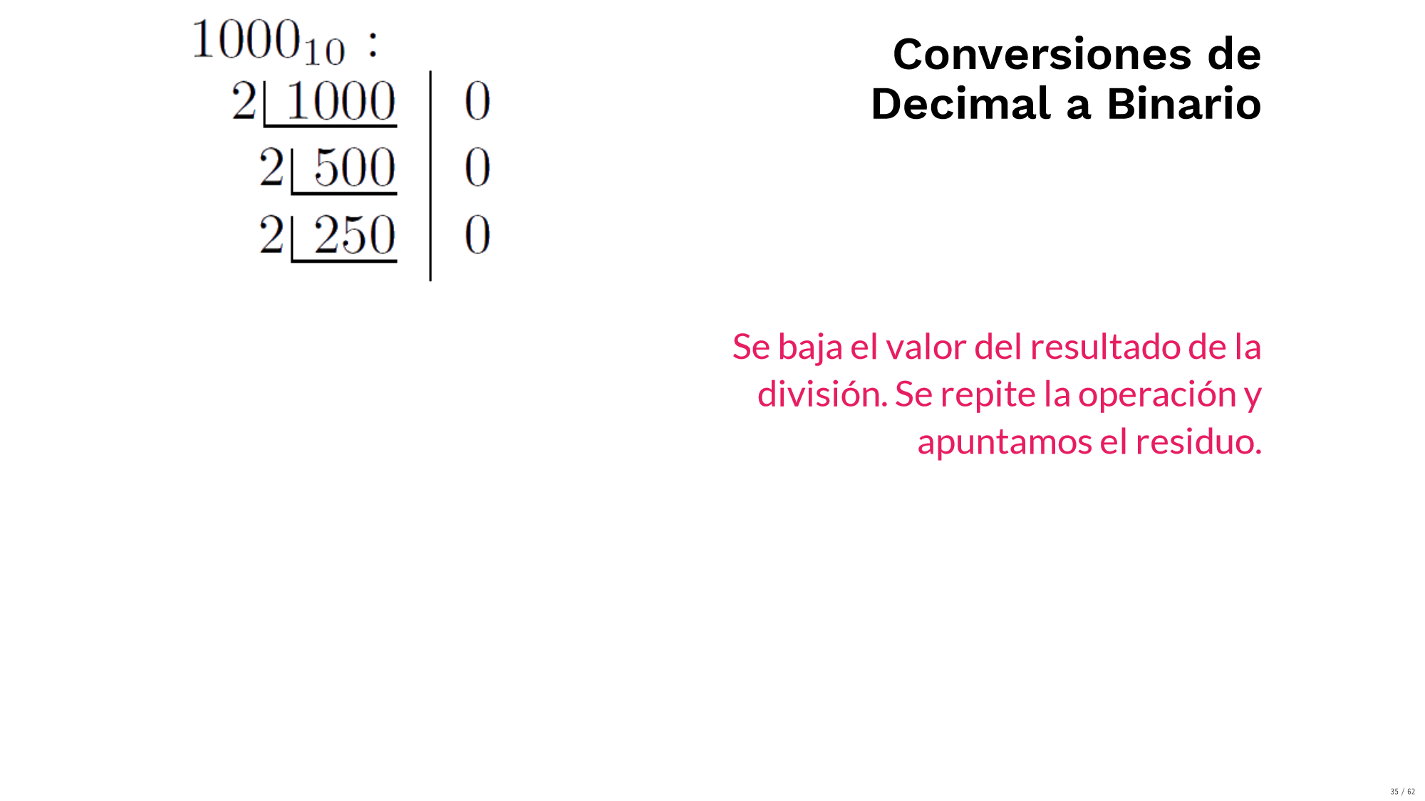
Decimal to Binary Conversion
Remainder
Result

Slide 48
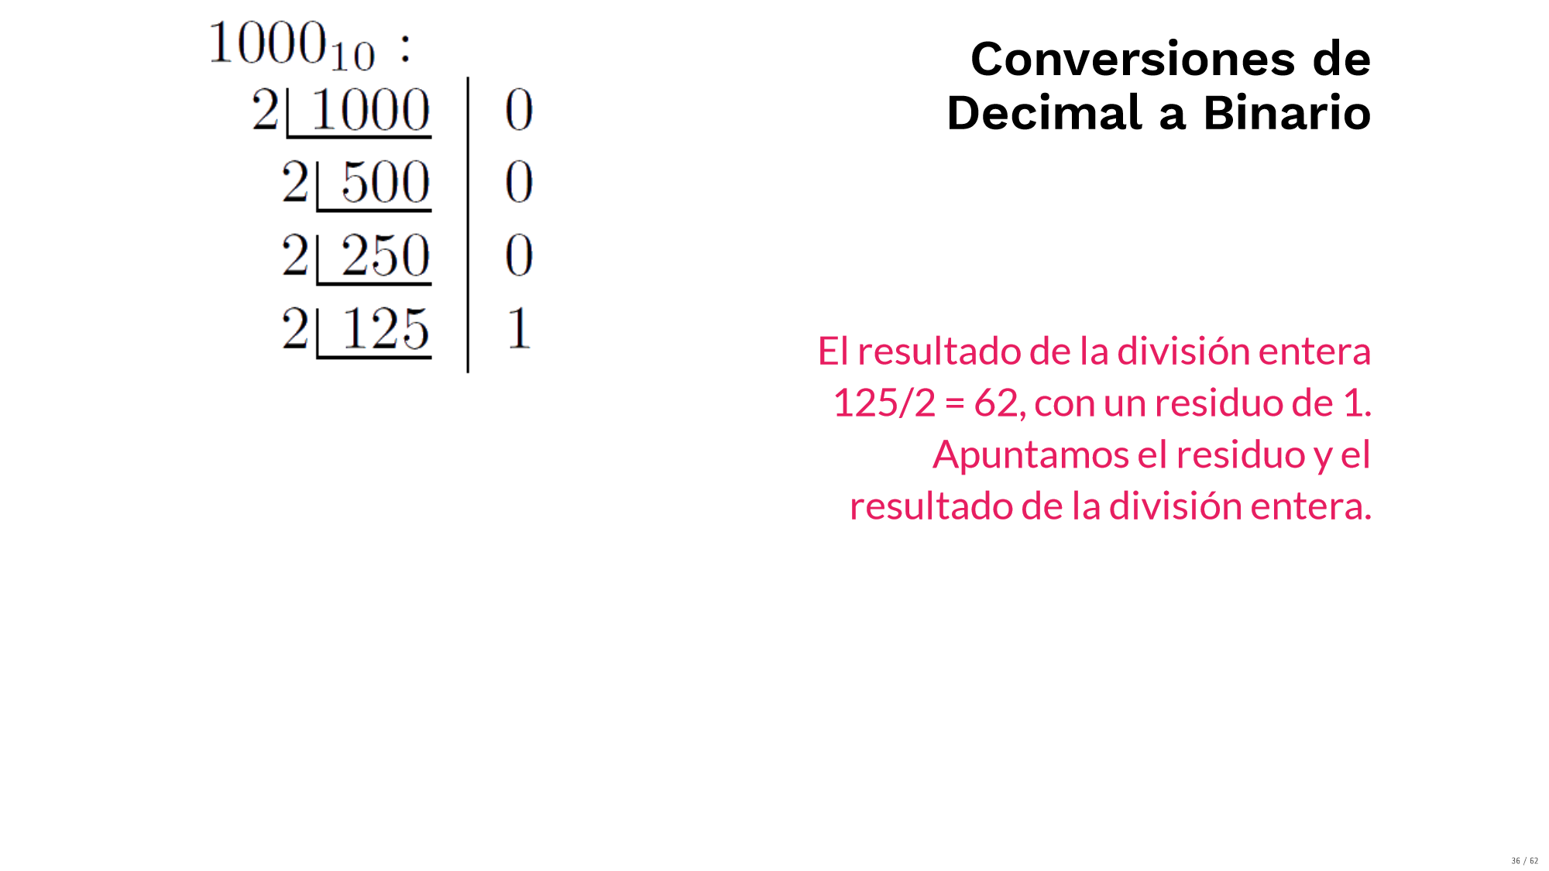
Decimal to Binary Conversion
The result of the integer division 125/2 is 62, with a remainder of 1.
Remainder
Result

Slide 49
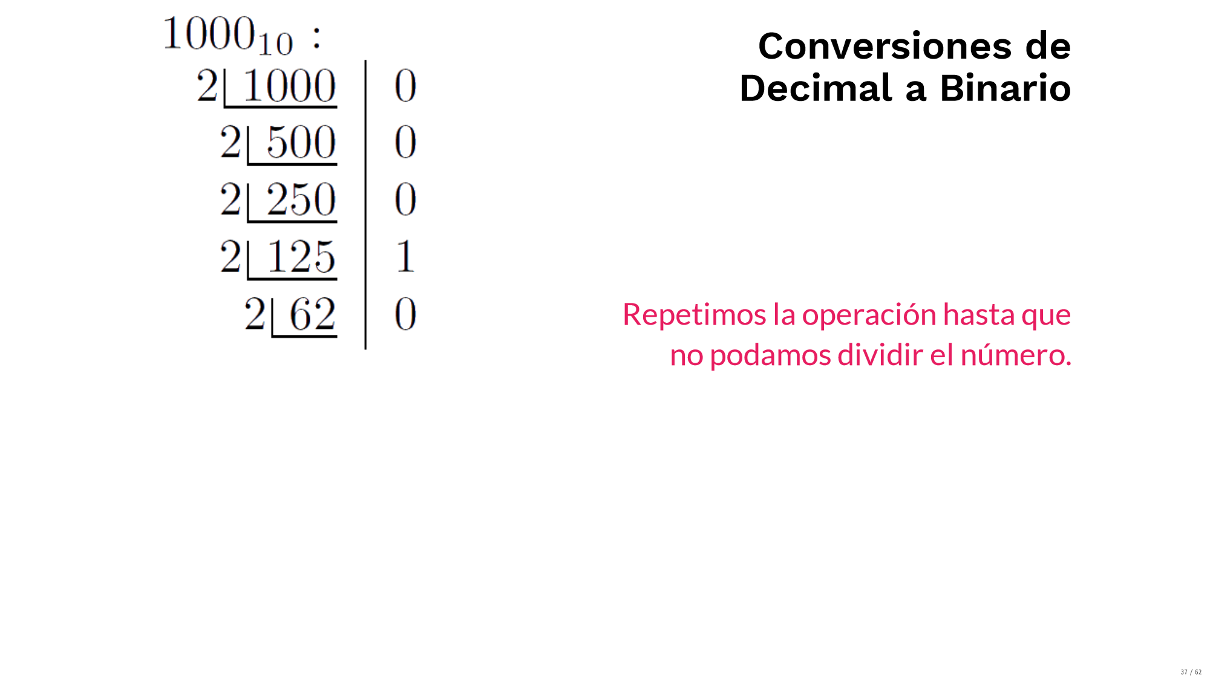
Decimal to Binary Conversion
We keep repeating this operation
Remainder
Result

Slide 50
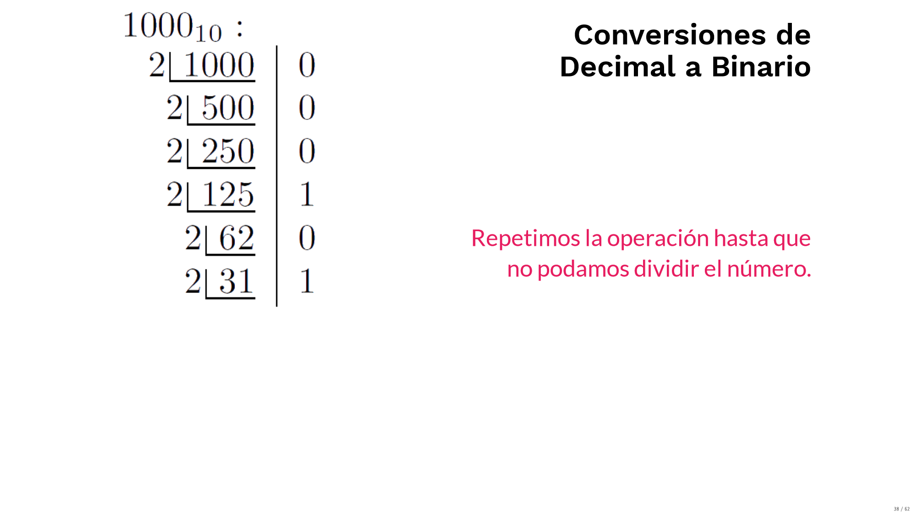
Decimal to Binary Conversion
Remainder
Result

Slide 51
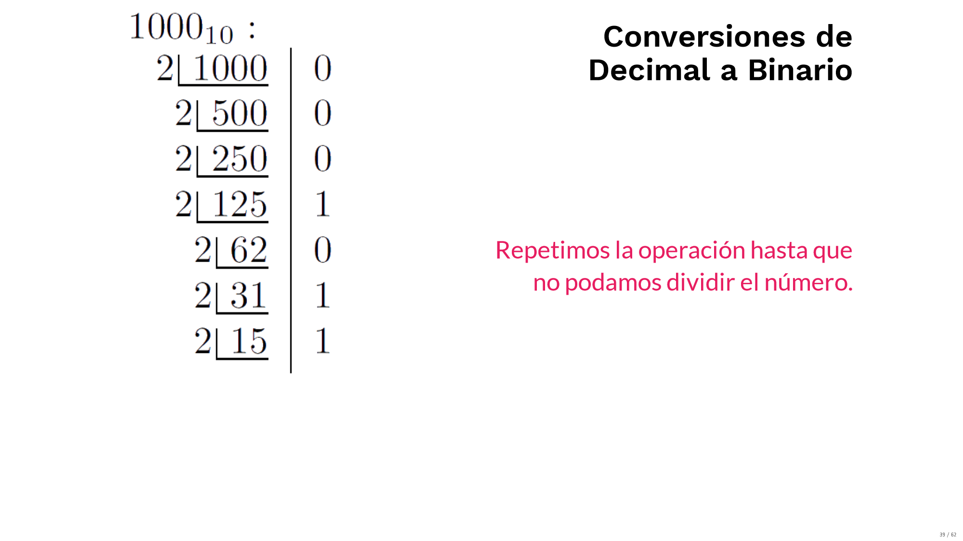
Decimal to Binary Conversion
Remainder
Result

Slide 52
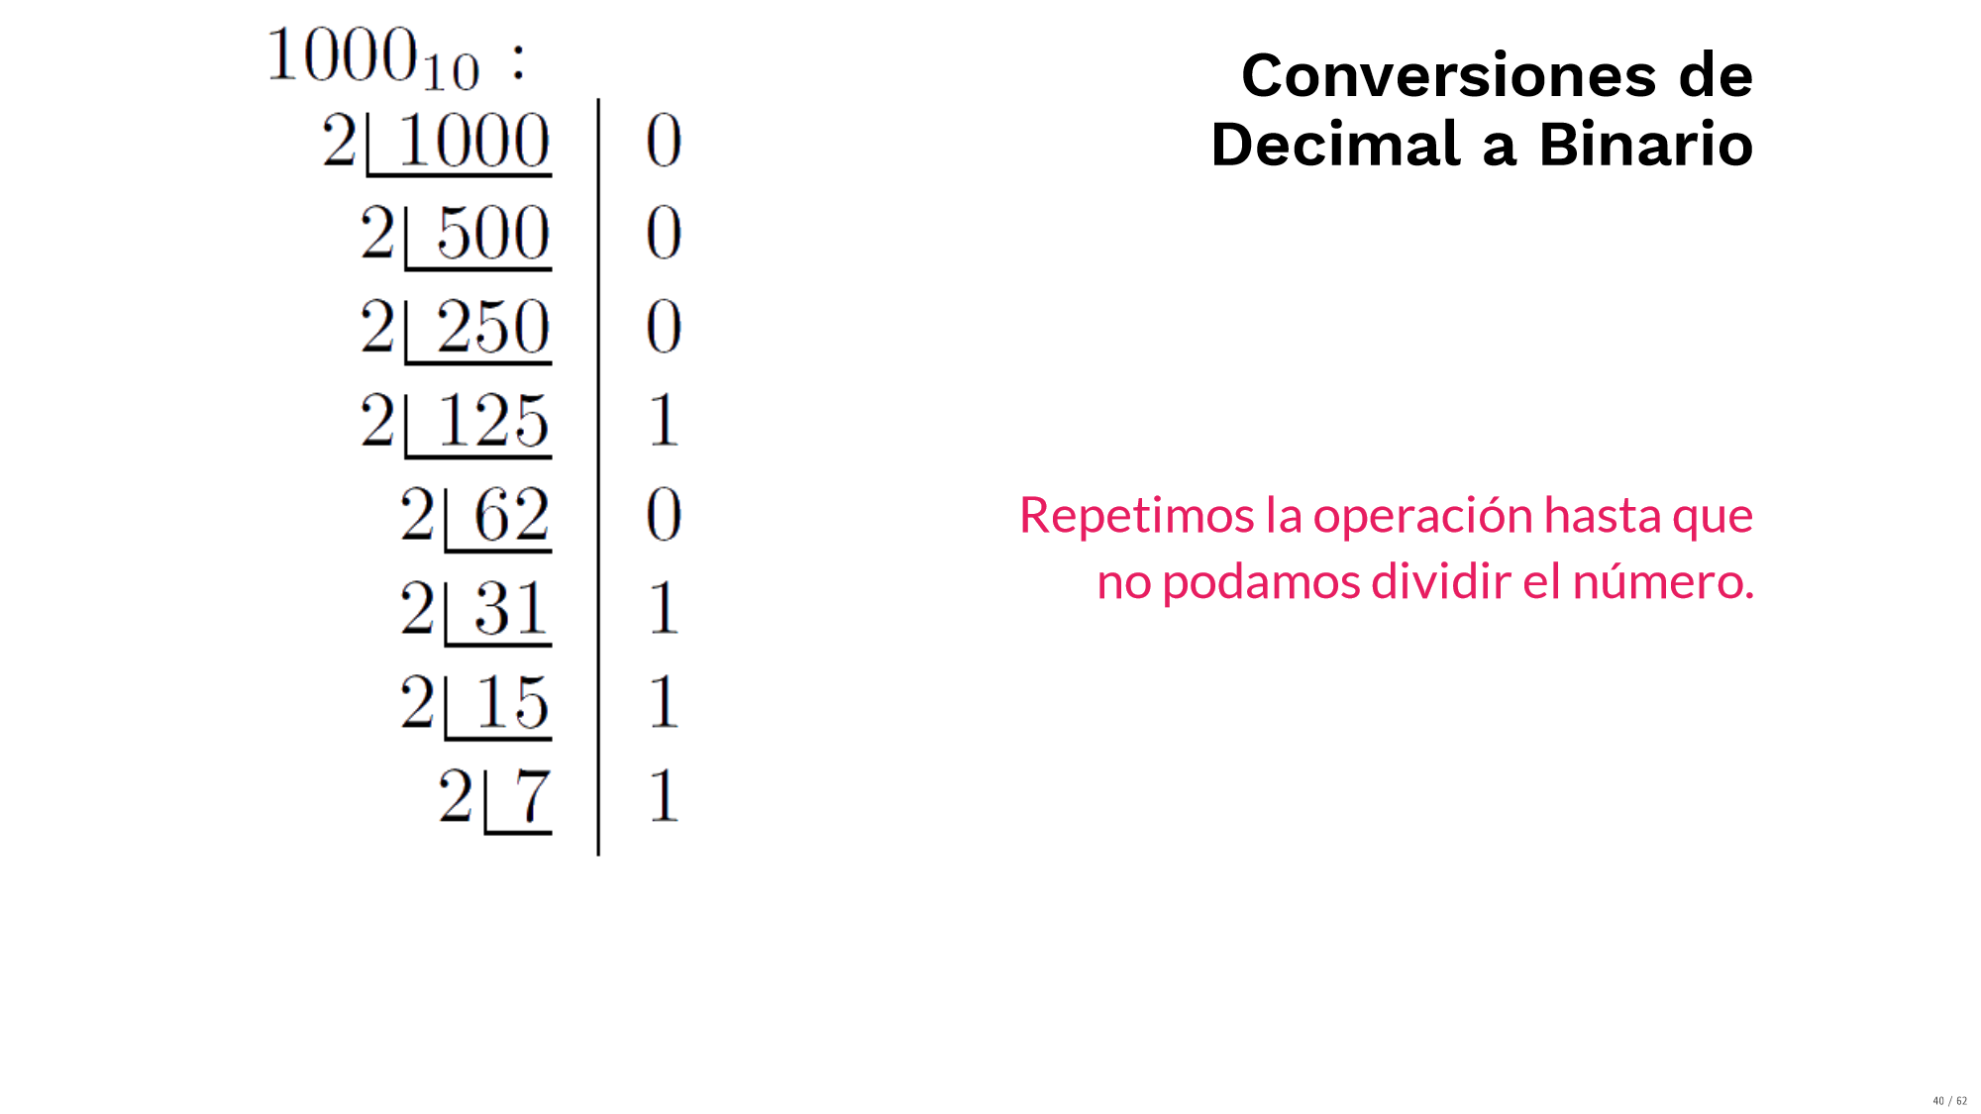
Decimal to Binary Conversion
Remainder
Result

Slide 53
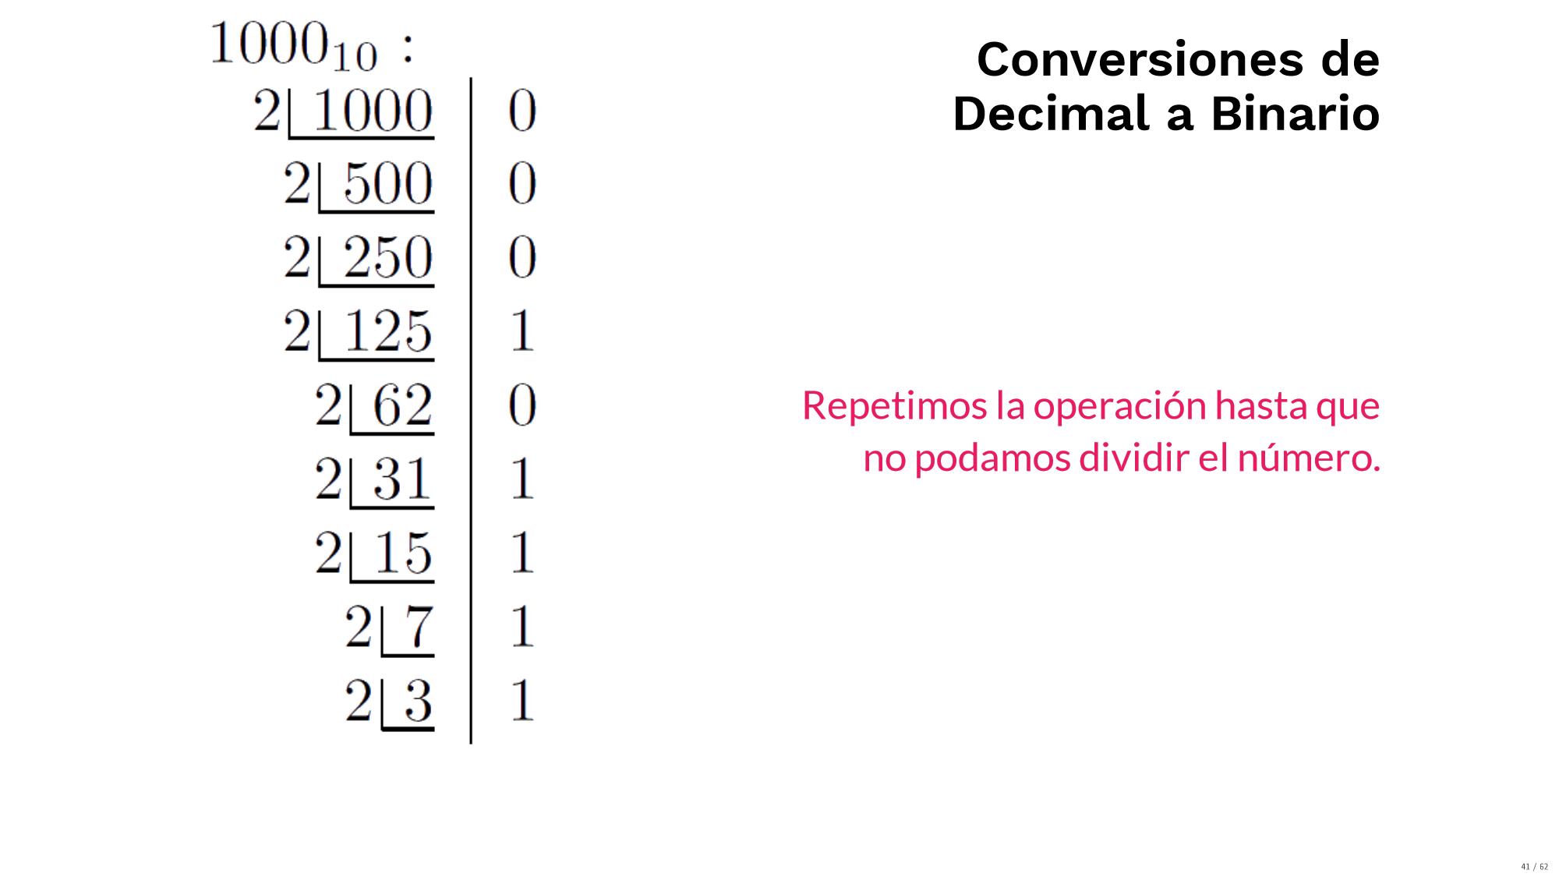
Decimal to Binary Conversion
Remainder
Result

Slide 54
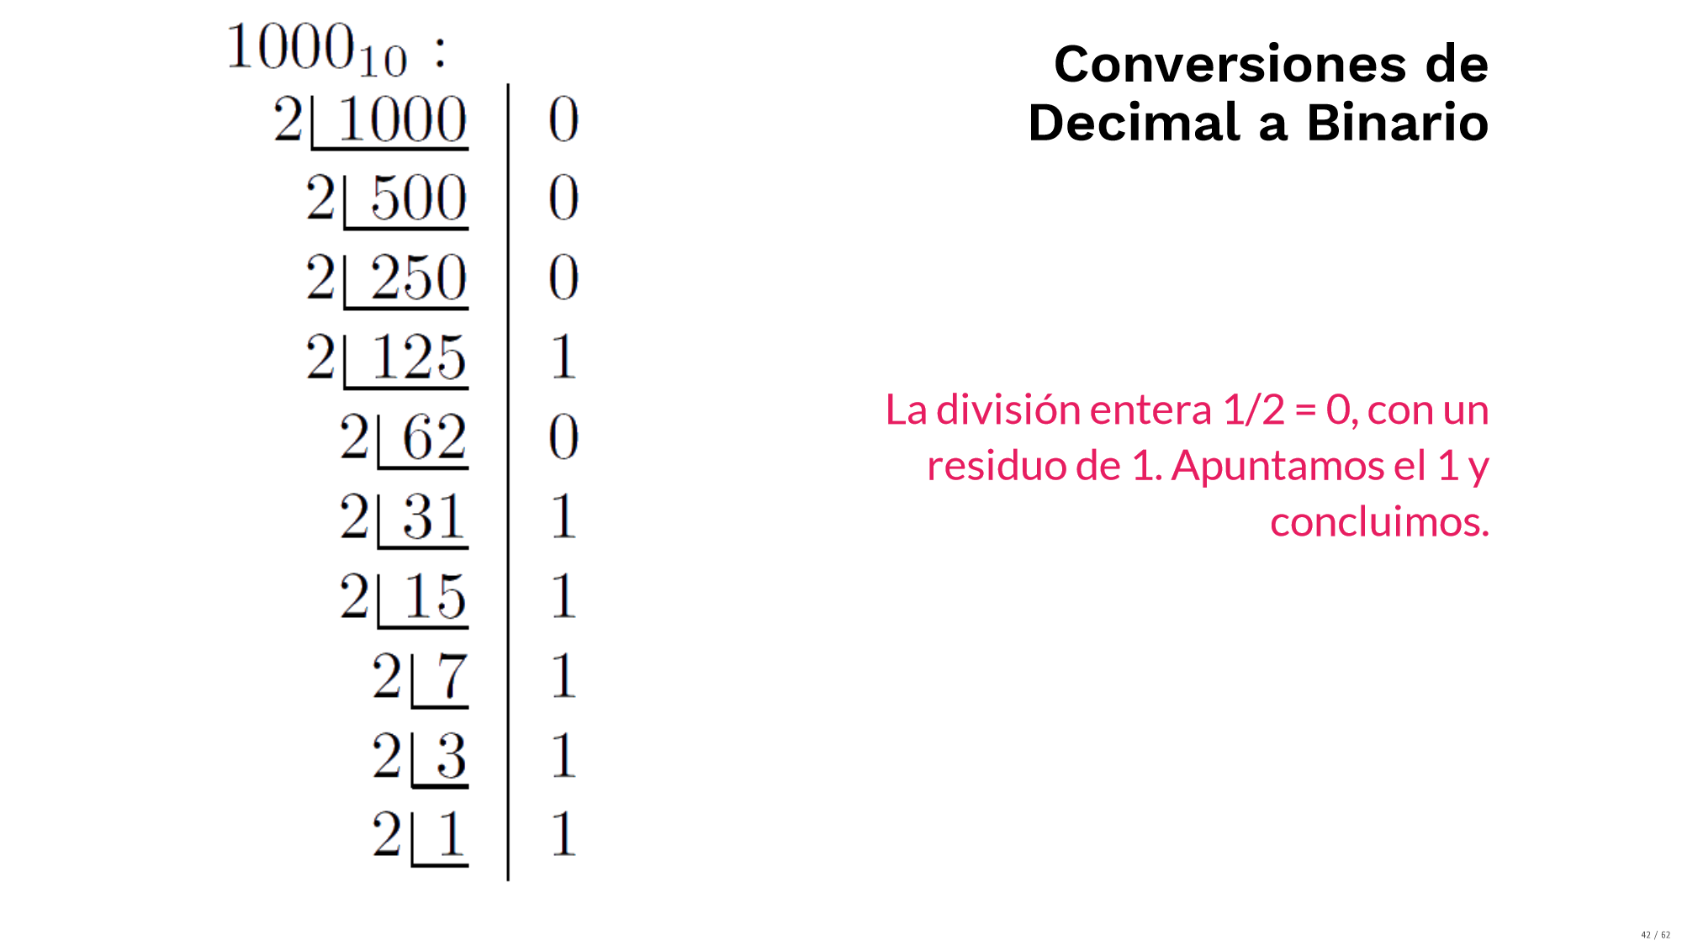
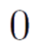
Decimal to Binary Conversion
The integer division 1/2 = 0, with a remainder of 1. We write the remainer and finish.
Remainder
Result is 0!

Slide 55
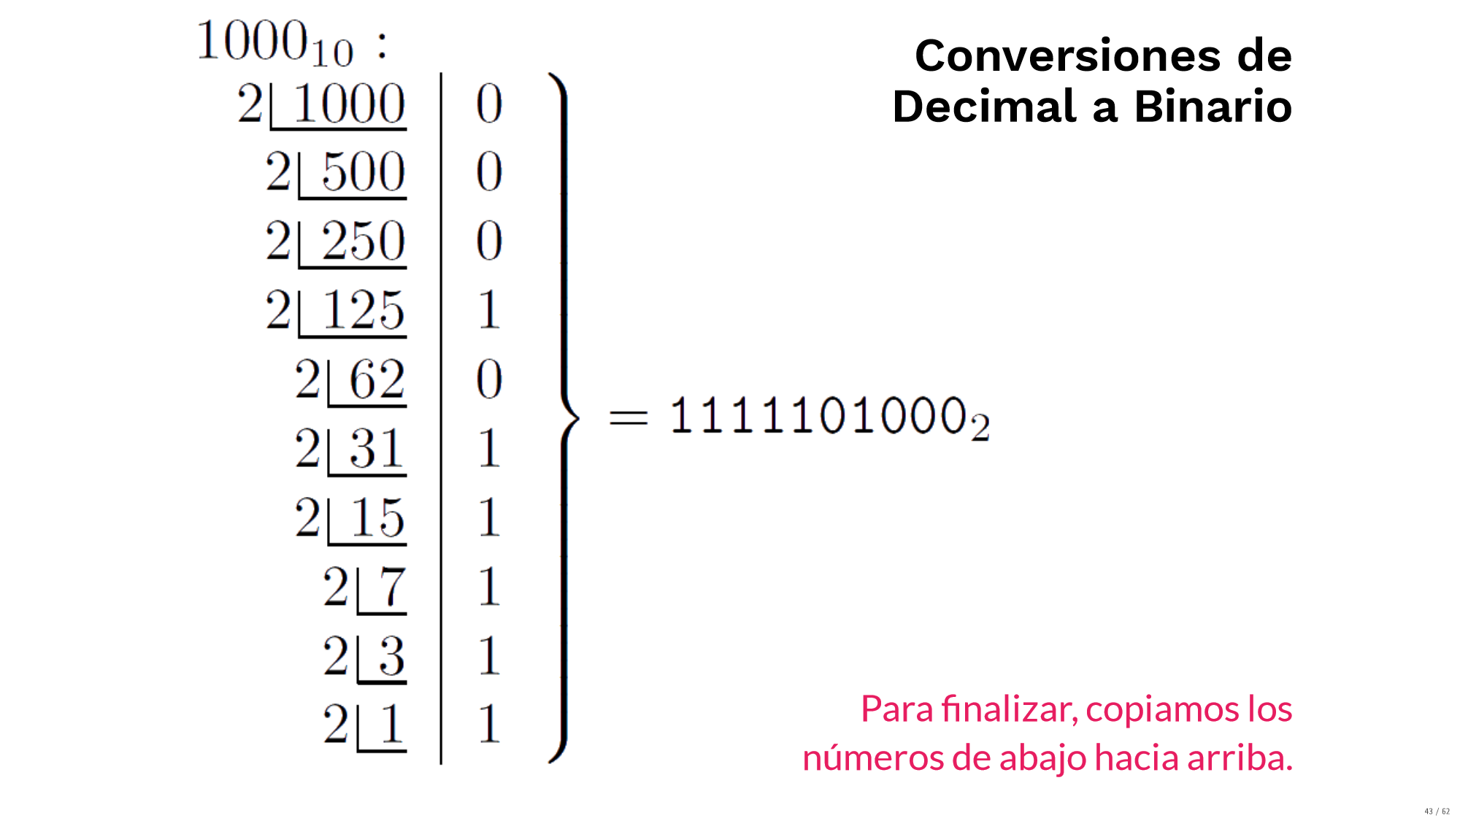
Decimal to Binary Conversion
To finish, we copy the numbers in sequence from bottom to top

Slide 56
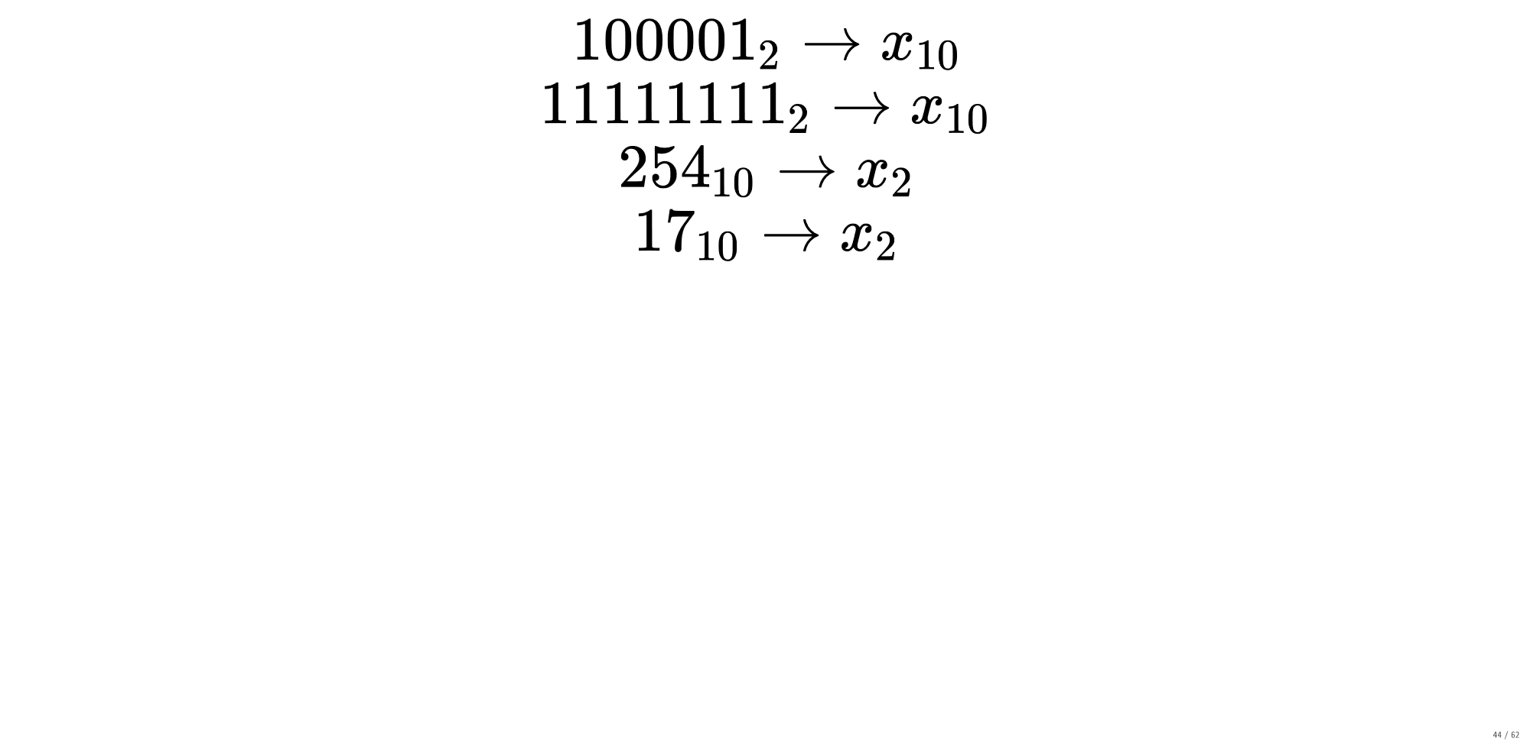
Individual Work

Slide 57
Hexadecimal System

Slide 58
Hexadecimal System
In hexadecimal system, each digit can represent 16 possible values. For this, the characters used go from 0 to 9 and letters from A to F.
Smallest number
Largest number

Slide 59
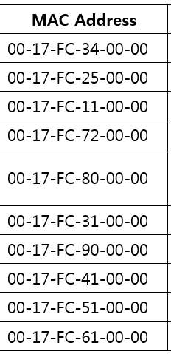
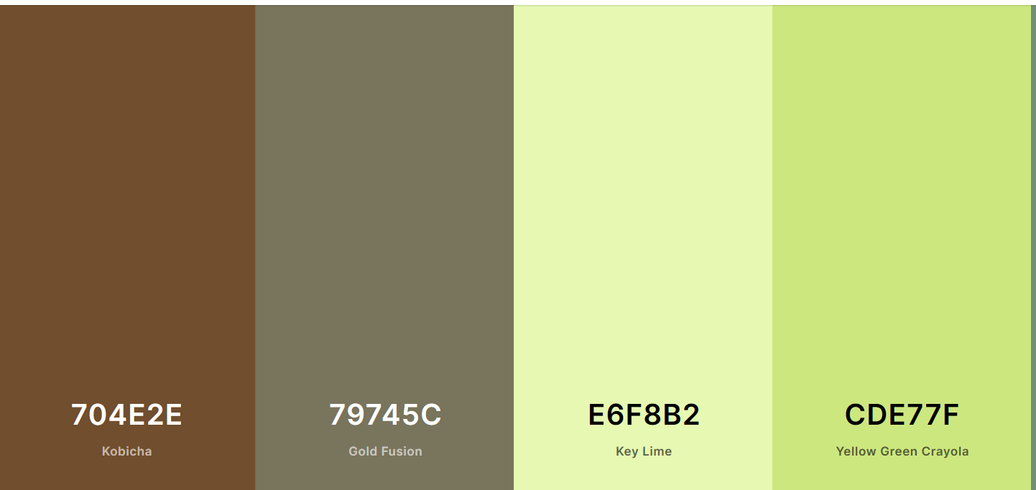
Where do we use hexadecimal numbers?
In networks, for computer MAC Addresses
To represent RGB colors

Slide 60
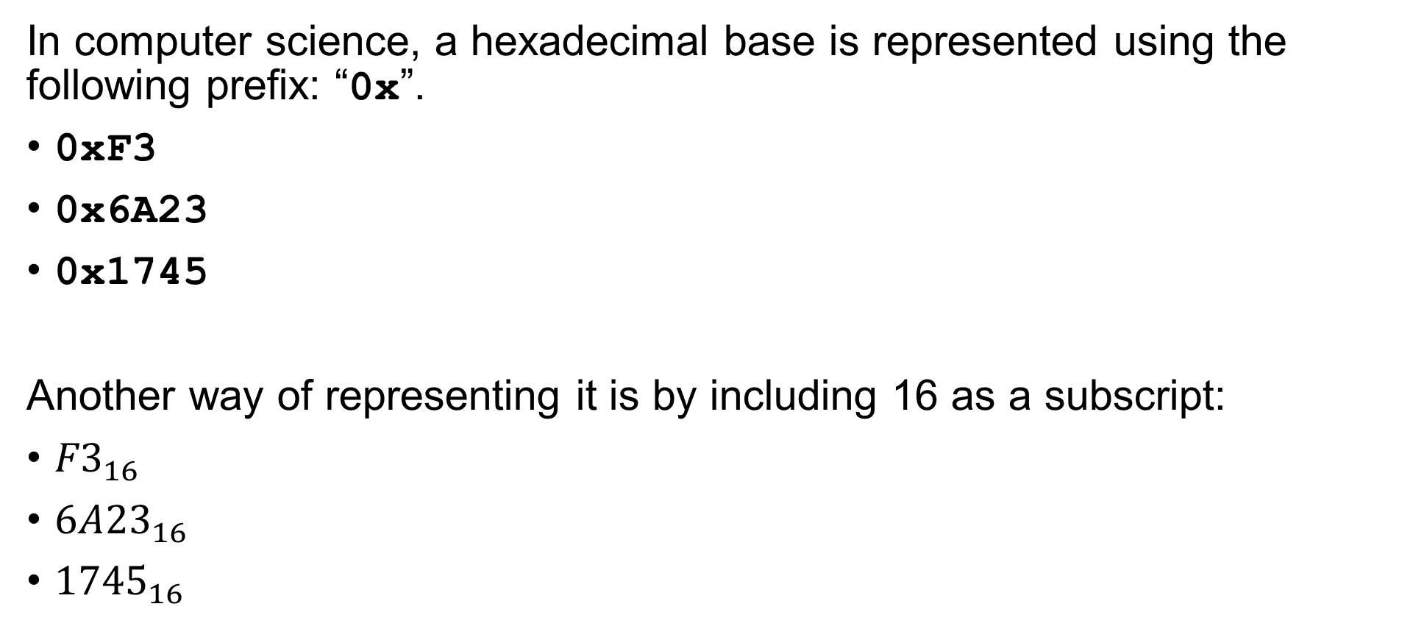
Hexadecimal System
In computer science, a hexadecimal base is represented using the following prefix: “0x”.
0xF3
0x6A23
0x1745
Another way of representing it is by including 16 as a subscript:
${F3}_{16}$
${6A23}_{16}$
${1745}_{16}$

Slide 61
0
1
2
3
4
5
6
7
8
9
A
B
C
D
E
F ← Largest value with 1 digit
10
11
12
13
14
15
16
17
18
19
1A
1B
1C
1D
1E
1F
20
…
FE
FF ← Largest value with two digits
100

Slide 62
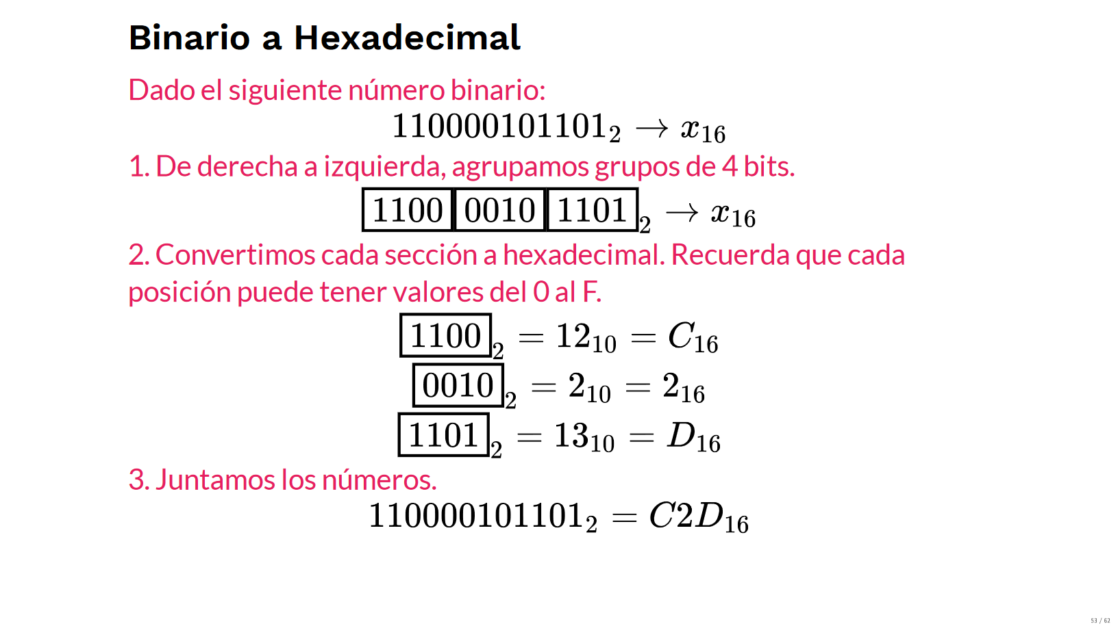
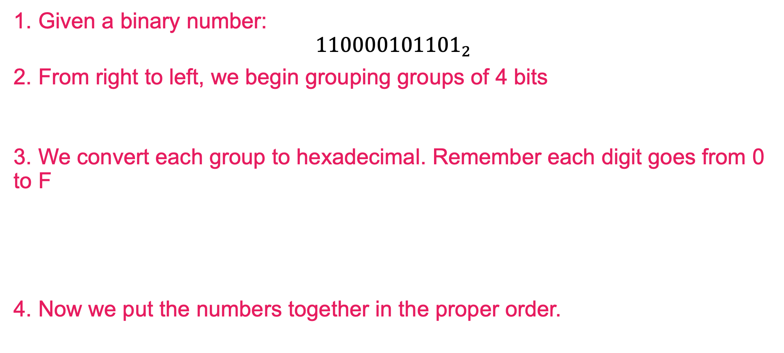
Binary to Hex Conversion
1. Given a binary number:
$${110000101101}_{2}$$
2. From right to left, we begin grouping groups of 4 bits
3. We convert each group to hexadecimal. Remember each digit goes from 0 to F
4. Now we put the numbers together in the proper order.

Slide 63
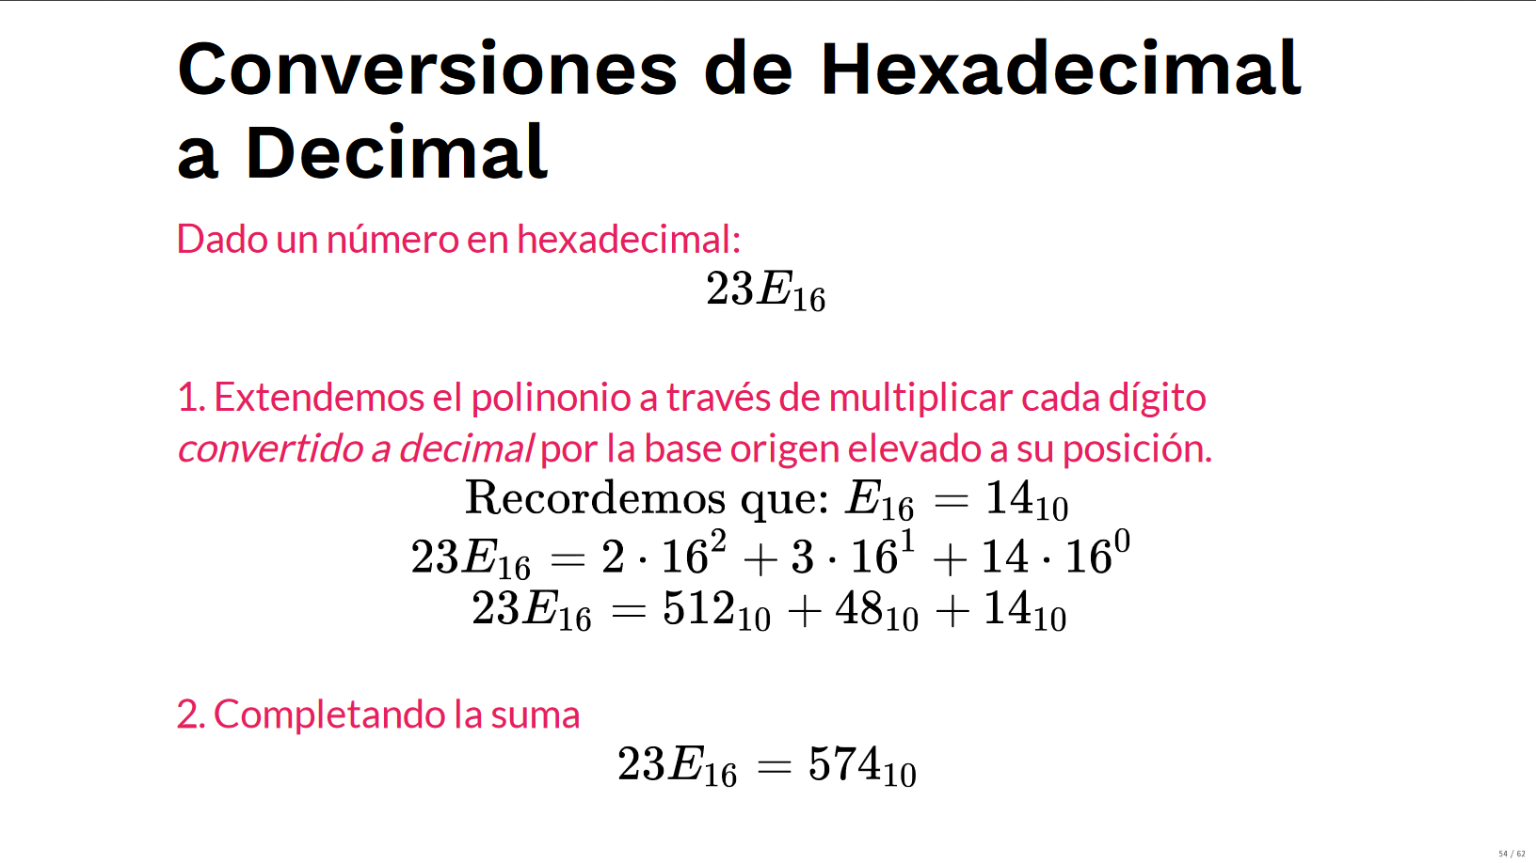
Hex to Decimal Conversions
Given a hexadecimal number:
2. We extend the polinomious by multiplying each digit (in decimal) and its base to the power of its position:
3. Add every factor:
Remember that:

Slide 64



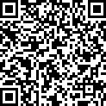
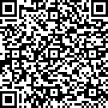
Individual work
https://flippybitandtheattackofthehexadecimalsfrombase16.com/

Slide 65
Data Encoding

Slide 66
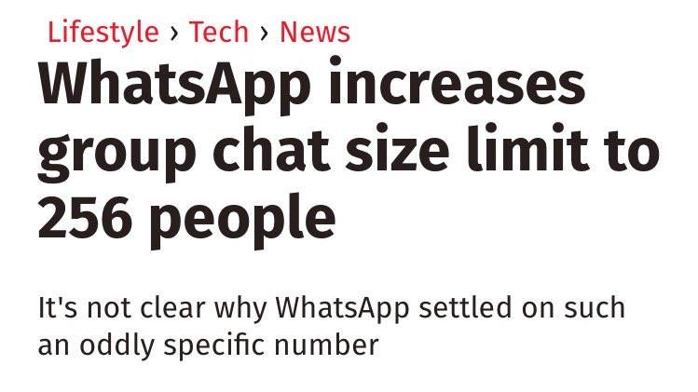

Slide 67
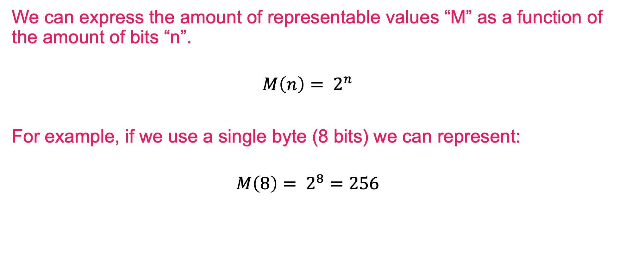
Data Encoding
We can express the amount of representable values “M” as a function of the amount of bits “n”.
$$M\left(n\right)= 2^{n}$$
For example, if we use a single byte (8 bits) we can represent:
$$M\left(8\right)= 2^{8}=256$$

Slide 68
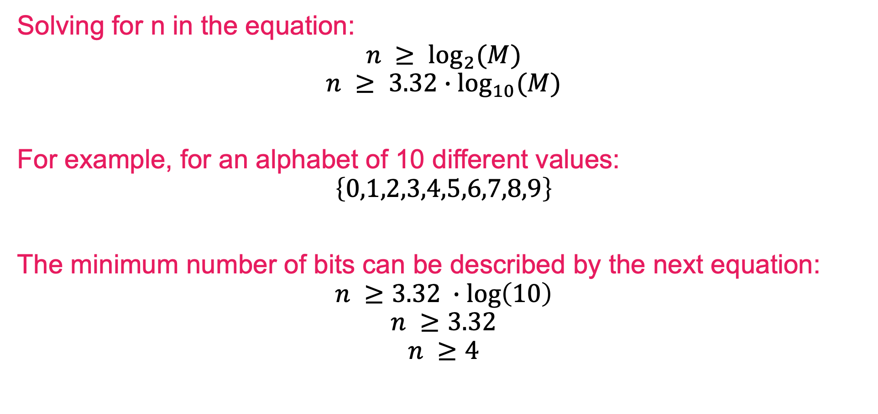
Data Encoding
Solving for n in the equation:
$$n ≥ \log_{2}{(M)}$$
$$n ≥ {3.32∙log}_{10}{(M)}$$
For example, for an alphabet of 10 different values:
$$\left\{0,1,2,3,4,5,6,7,8,9\right\}$$
The minimum number of bits can be described by the next equation:
$$n ≥3.32 ∙\log\left(10\right)$$
$$n ≥3.32$$
$$n ≥4$$

Slide 69
Here is an alternative method.
1
1 bit
000
001
010
011
0
3 bits
100
101
110
111
00
0000
0001
0010
0011
01
0100
0101
0110
0111
2 bits
4 bits
10
1000
1001
1010
1010
11
1100
1101
1110
1111

Slide 70
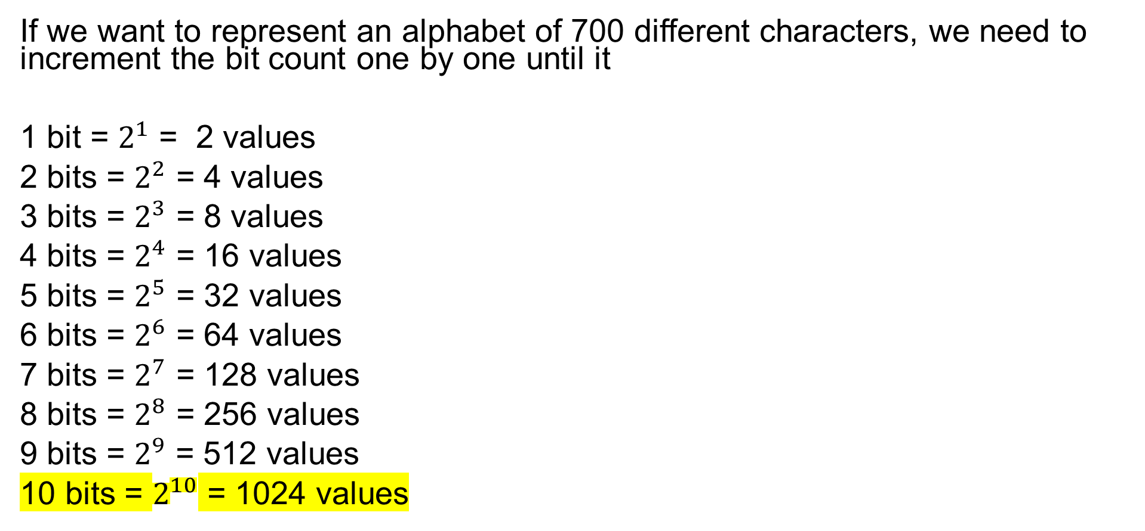
Example
If we want to represent an alphabet of 700 different characters, we need to increment the bit count one by one until it
1 bit = $2^{1}$ = 2 values
2 bits = $2^{2}$ = 4 values
3 bits = $2^{3}$ = 8 values
4 bits = $2^{4}$ = 16 values
5 bits = $2^{5}$ = 32 values
6 bits = $2^{6}$ = 64 values
7 bits = $2^{7}$ = 128 values
8 bits = $2^{8}$ = 256 values
9 bits = $2^{9}$ = 512 values
10 bits = $2^{10}$ = 1024 values

Slide 71
